Slide 1

HDS Tutorial 3 Week 6

Slide 2
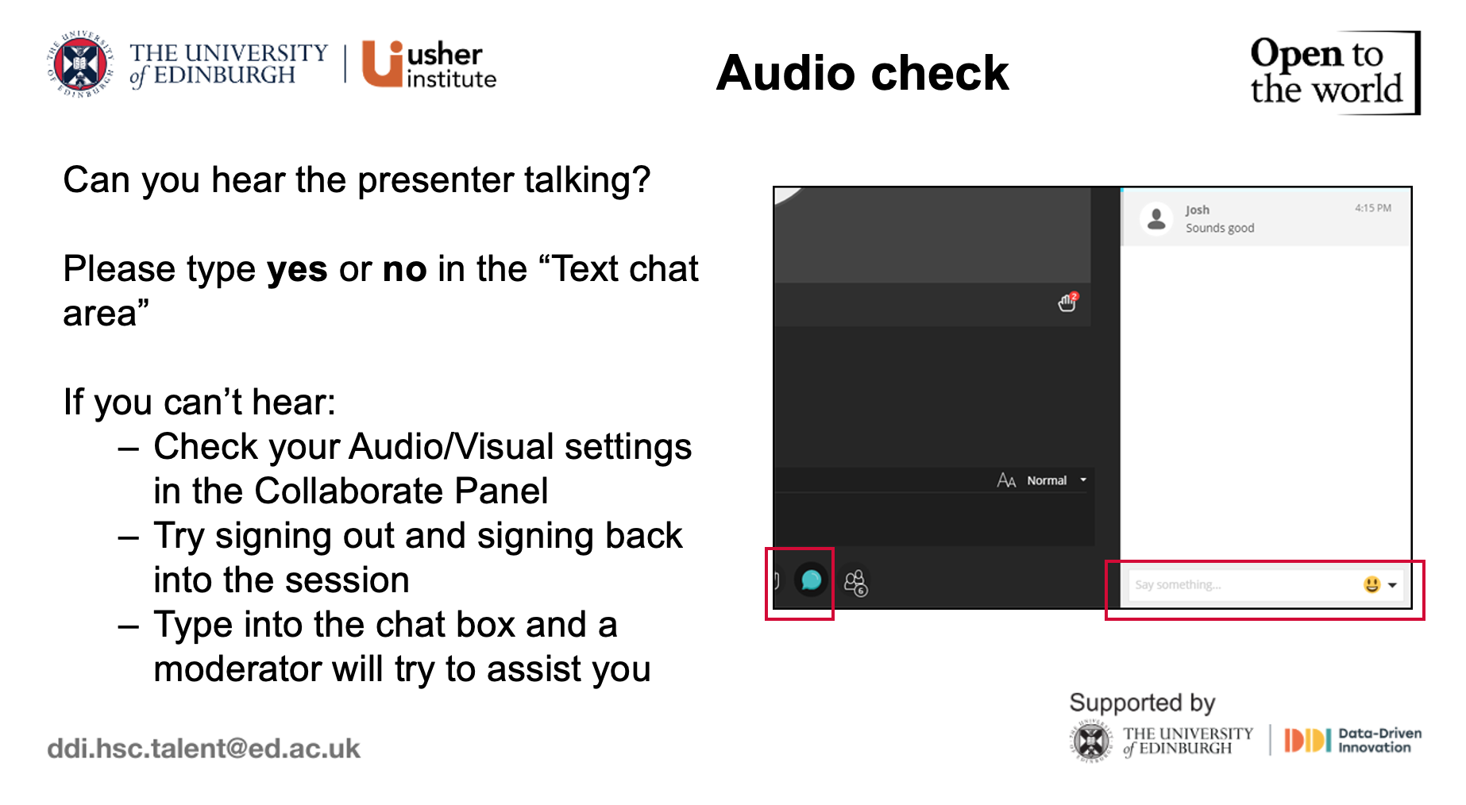

Slide 3
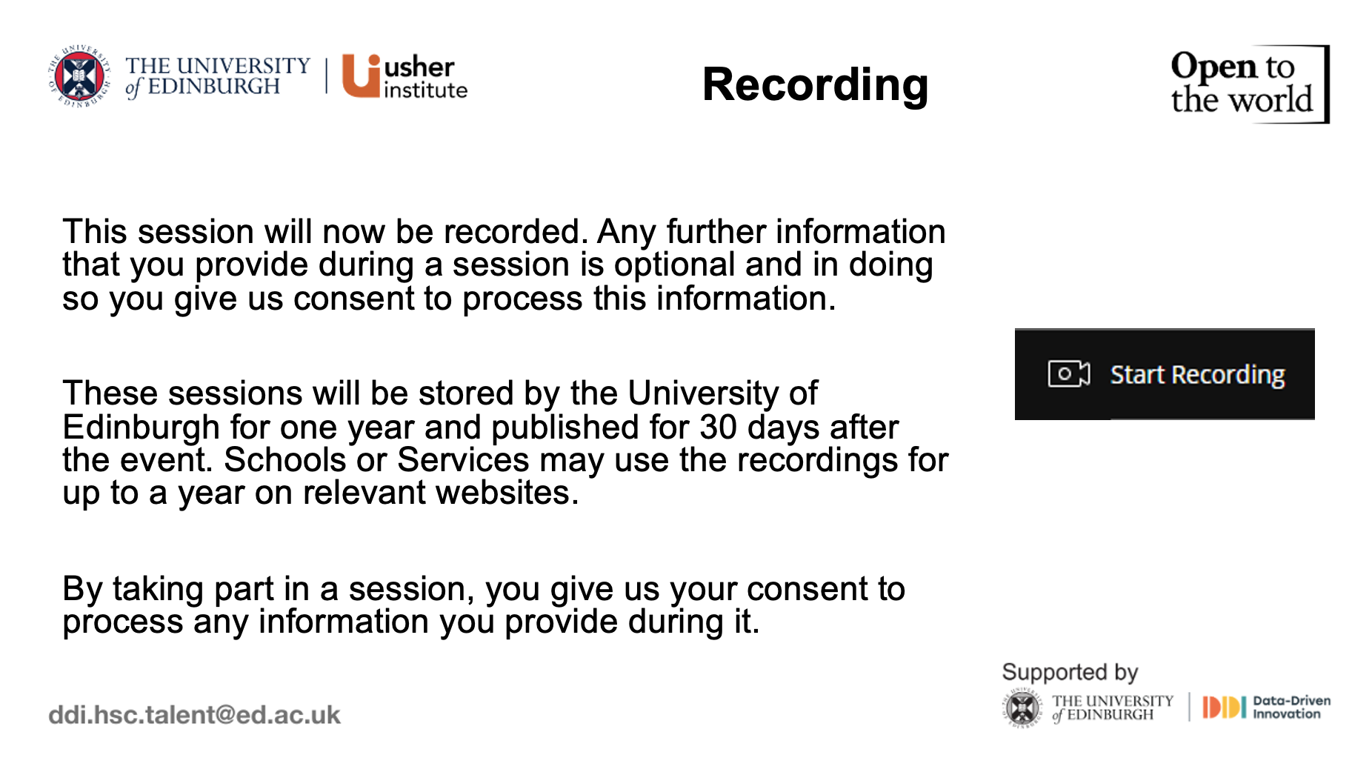

Slide 4
HDS Tutorial 3 Week 6

Slide 5

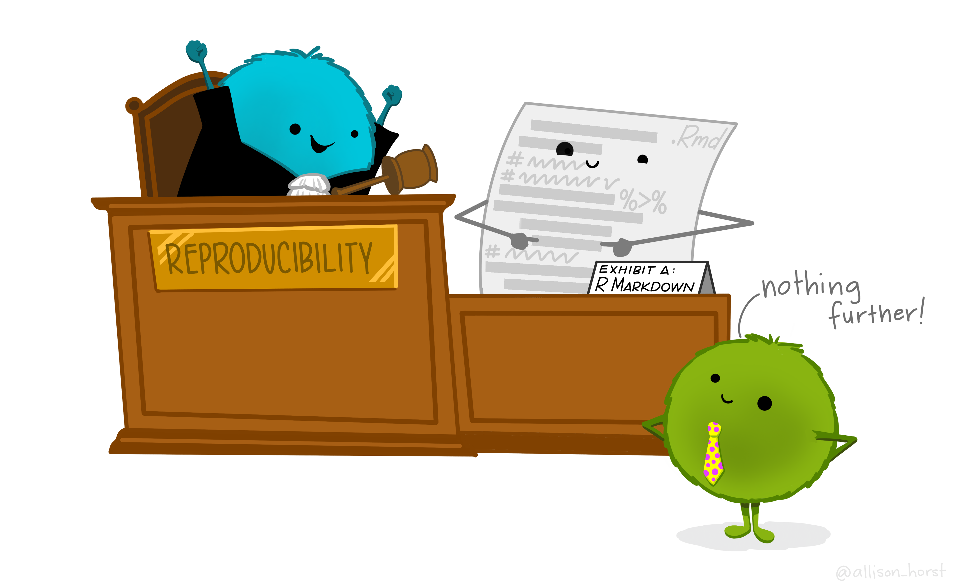
Agenda
What is R Markdown
Why use R Markdown
Demonstration
Resources for further study
Q&A
Artwork by Allison Horst

Slide 6
Have you installed all of the necessary packages for R Markdown?

Slide 7
Have you already looked through some of this week’s content (i.e., opened the R Markdown practice document?)

Slide 8
You might be thinking…
Okay… but why R Markdown, why should we not just stick with script files?

Slide 9
Less
An R Markdown workflow is…
More
Dynamic
Reproducible
Transparent
Error-prone
Time consuming (once you get the hang of it)

Slide 10
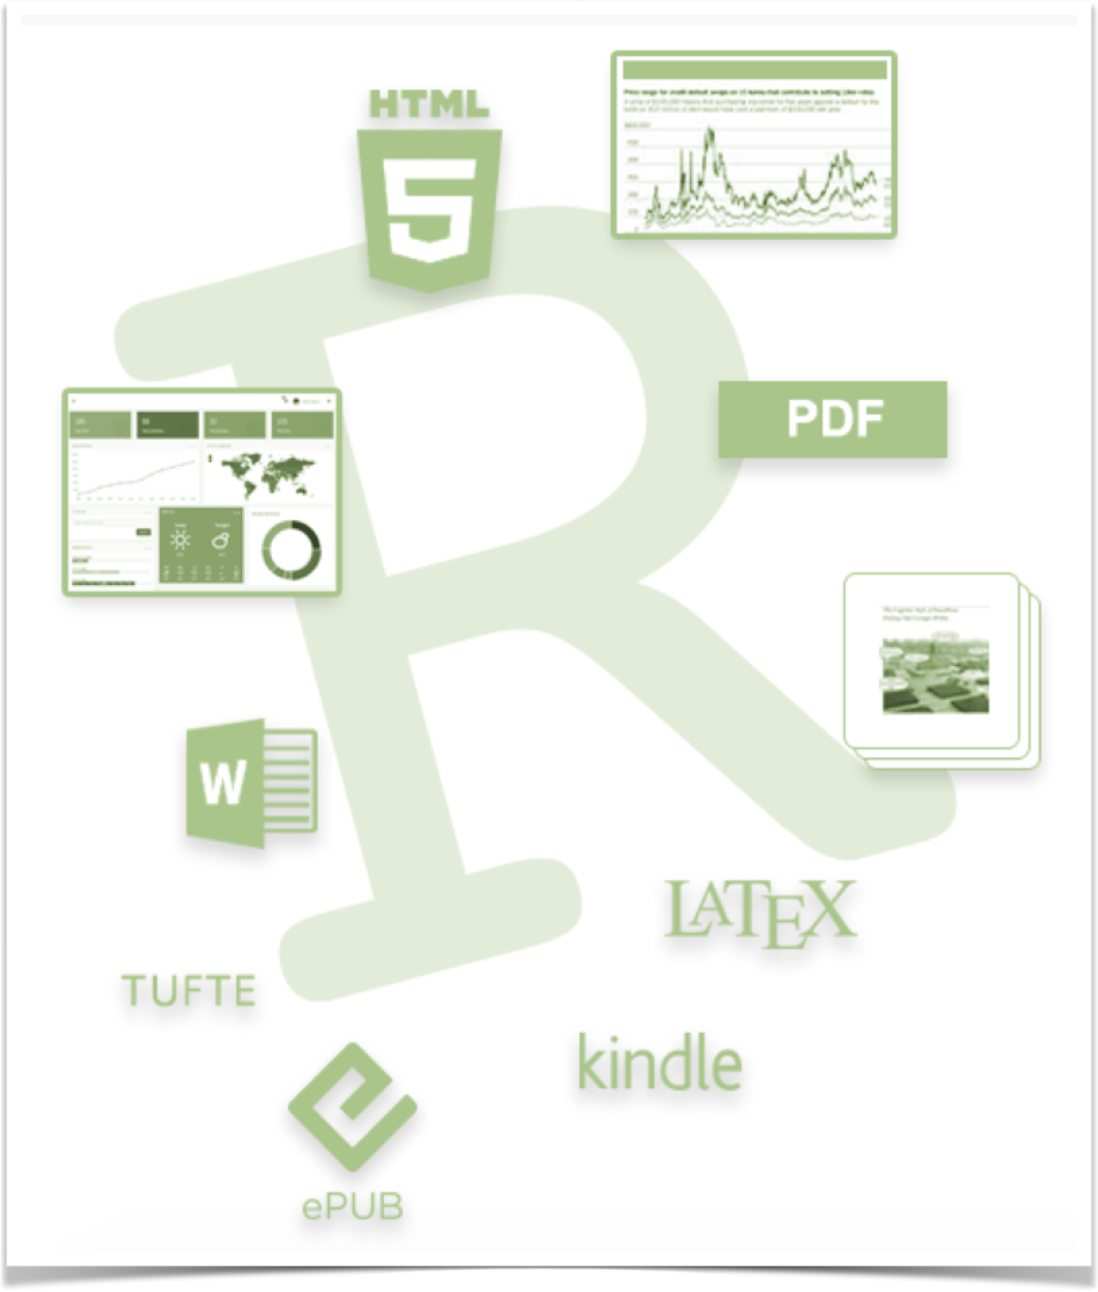
Create dynamic documents that combine code, output (including figures + tables), and writing
Same document holds code & narrative surrounding the data -- an authoring framework for data science!
Can be used to…
Reproduce your analyses
Collaborate and share code with others
Communicate your findings with others (even those who do not understand code)

Slide 11
Present analyses in high quality documents, reports, and presentations
Support dozens of output formats, like PDFs, Word files, slideshows, and more
Documents are fully reproducible — you can update your document at any time by re-knitting the code chunks
Productive notebook interface weaves together narrative text & code to produce elegantly formatted output
Can use multiple languages including R, Python, and SQL

Slide 12
R Markdown as…
Literate Programming
A Data Product
A Control Document
Templating
Credit: Thomas Mock’s blog
(Customer Success Manager @ Rstudio)

Slide 13
R Markdown: Literate Programming
Goal: Capture code, text/comments, and output in a single document
MVP of reproducibility
HAS to run successfully to save/knit the output
Self-documenting (code is embedded)
Self-contained workspace
Exploratory Data Analysis

Slide 14
R Markdown: As a data product
Goal: Generate output natively in R for general consumption
Presentations (ppt, web-formats – xaringan, LateX formats - Beamer)
Dashboards (flexdashboard)
Reports (HTML, Word, PDF)
Websites & Blogs (blogdown, distill)
Books & Manuscripts (bookdown)

Slide 15
R Markdown: As control document
Goal: Scale data science tasks, automate the boring stuff, create robust pipelines
Automation with parameters
Child documents
R Markdown for emails with blastula

Slide 16
R Markdown: As templating
Goal: Don’t repeat yourself, generate input templates or output documents from code
Knit with knit::render() which lets you generate R Markdown outputs programmatically with code
Looping outputs
Templating engines whisker or usethis::use_template()

Slide 17
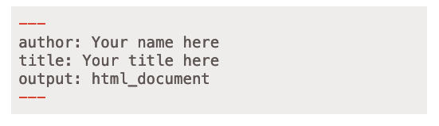
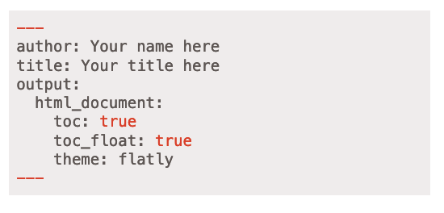
(1) YAML = metadata
Save output options here
Different syntax/language than the rest of the document
Watch out for your spaces!

Slide 18

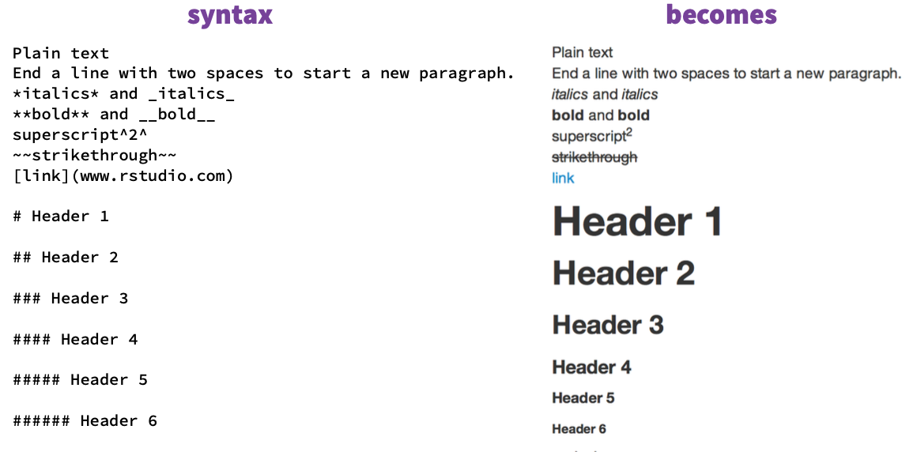
(2) Text & (3) Code
Code chunks!
You can think of each chunk sort of like a mini-script file within the larger document
Text written following Markdown

Slide 19
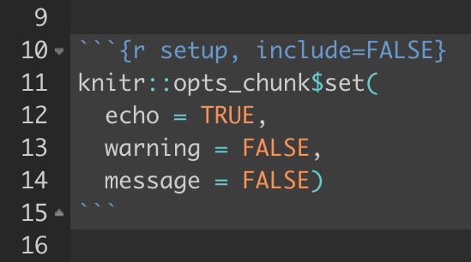
(3b) Global Setup chunk
A special chunk label: setup
Typically the first chunk
All following chunks will use these options because it sets globally the chunk options – hence “global set up chunk”
Set include = FALSE so that is is not printed out
You can (and should) use individual chunk options too

Slide 20
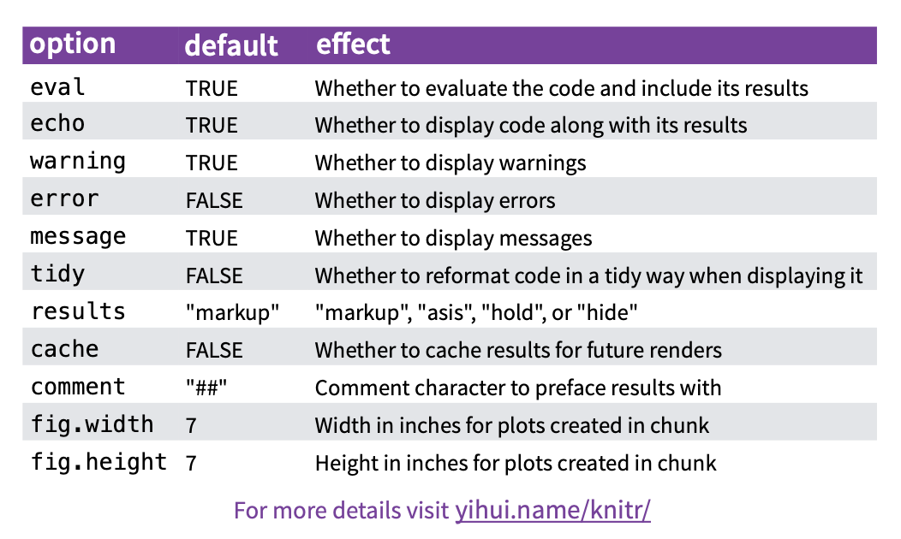
Code Chunk Options

Slide 21
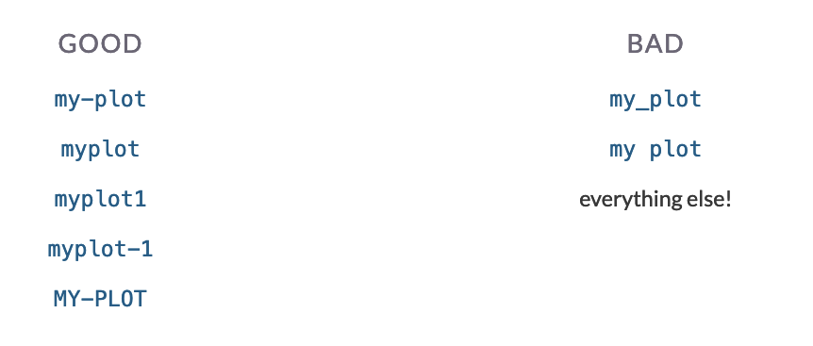
Chunk Labels
Place between curly braces
{r label}
Separate options with commas
{r label, option1=value}
No duplicate chunk labels! You will get an error

Slide 22
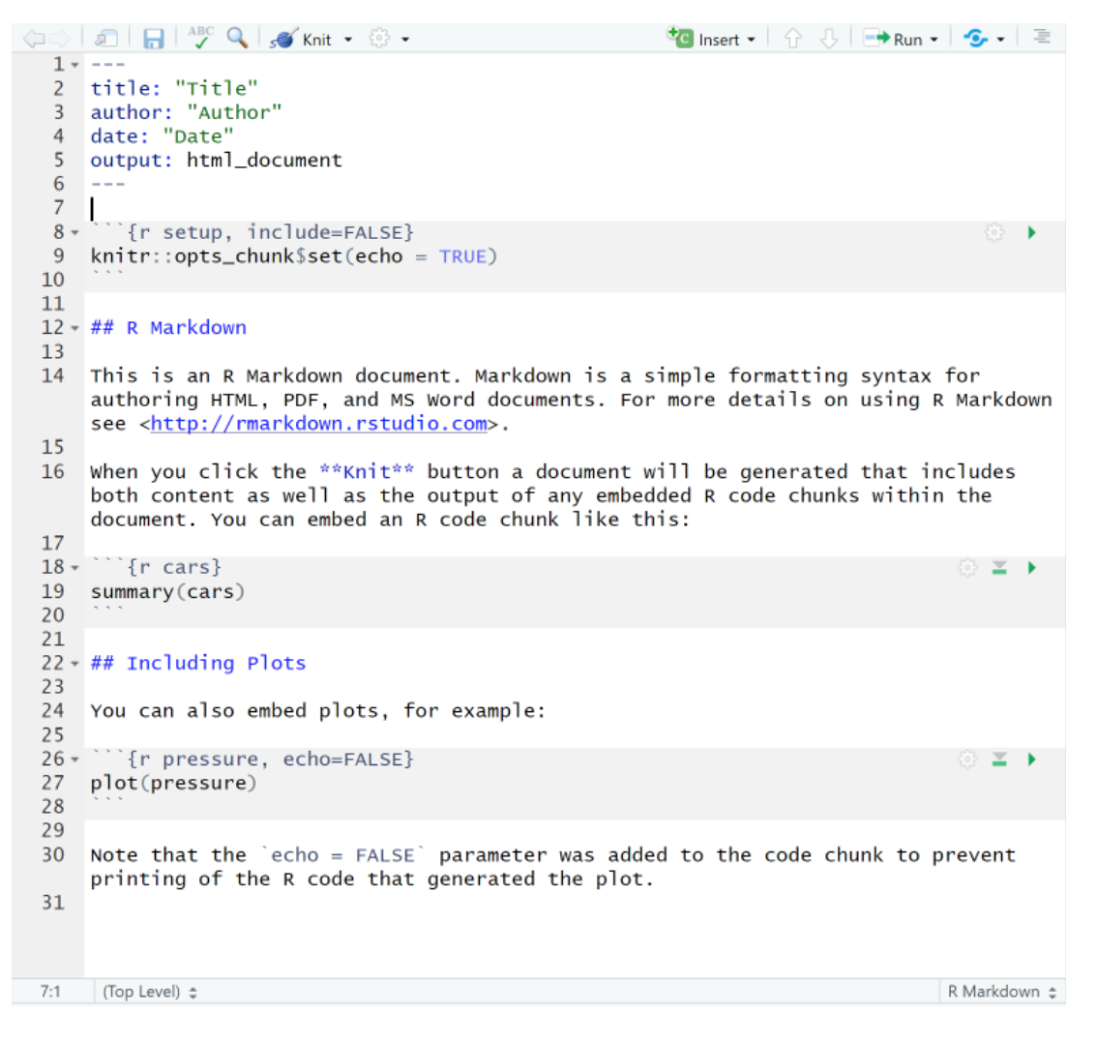
YAML
Code –
setup chunk
Text
Code
Text
Code
Text

Slide 23
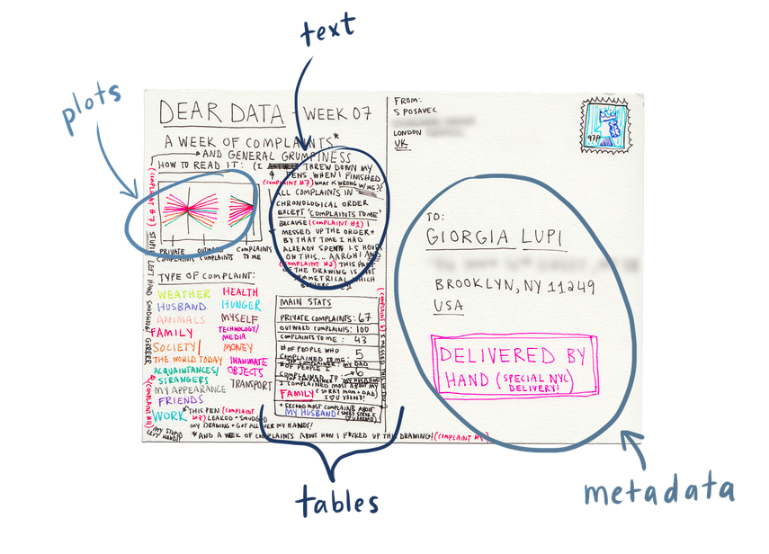
R Markdown as a postcard
Credit: Allison Hill
https://www.apreshill.com/

Slide 24
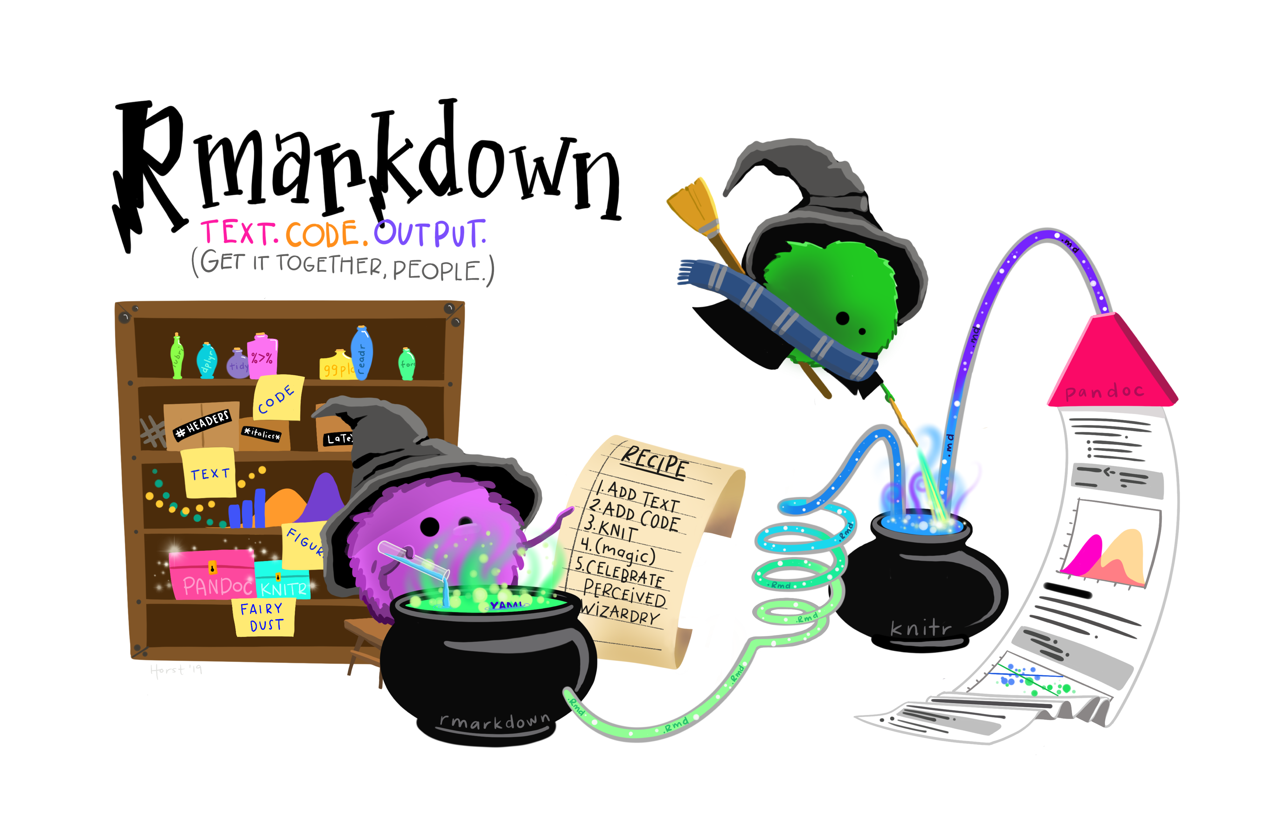

Slide 25
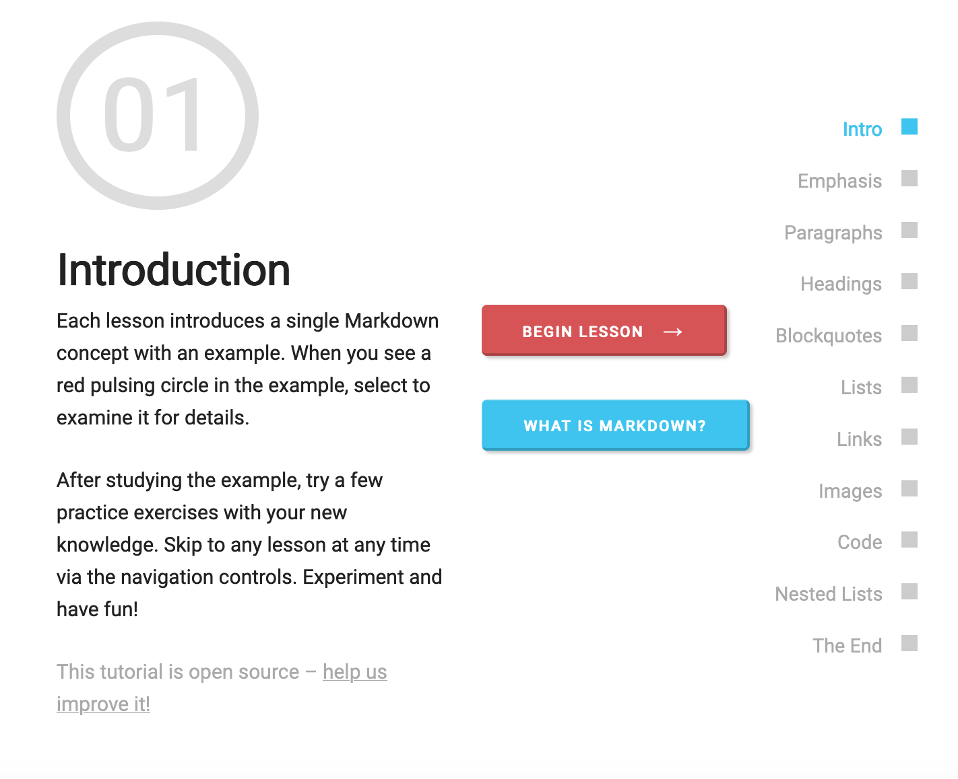
If you have not done so already, try the following tutorial
https://commonmark.org/help/tutorial/
Takes about 10 minutes

Slide 26
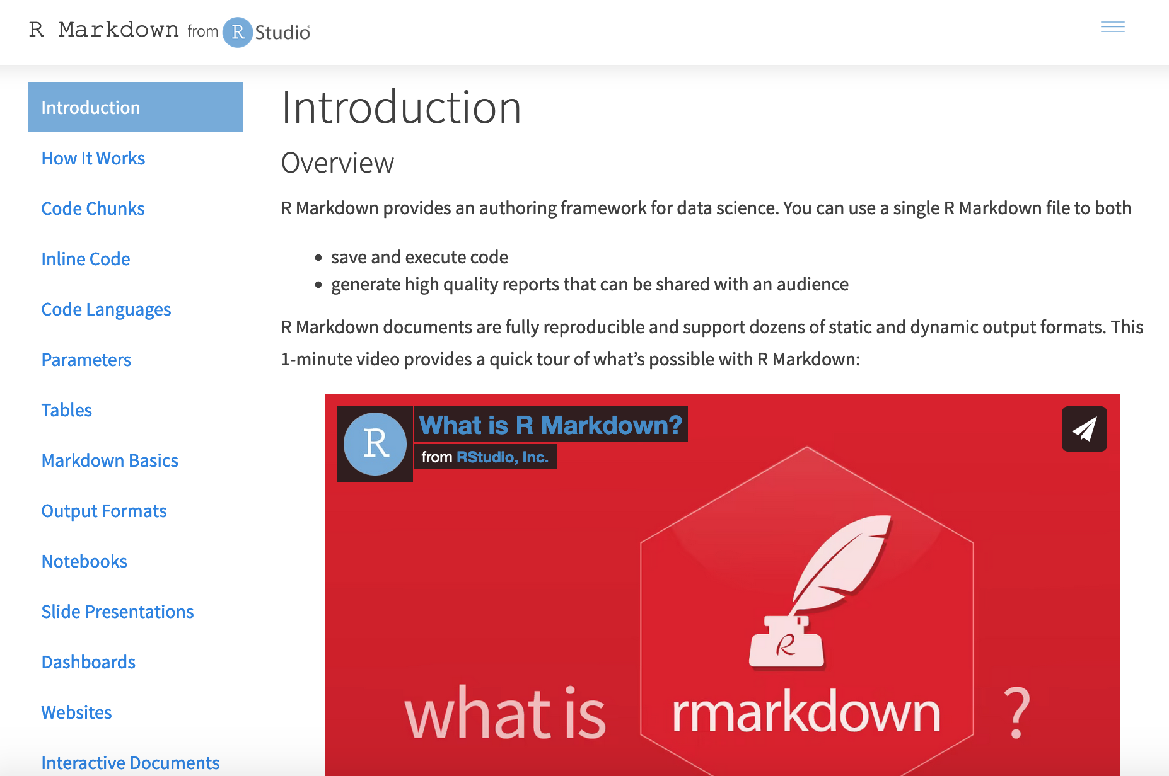
R Studio also has a longer self-paced tutorial
https://rmarkdown.rstudio.com/lesson-1.html

Slide 27

General go-to R Markdown resource
https://bookdown.org/yihui/rmarkdown/
By 2 of the authors of the knitr package!

Slide 28
Questions?

Slide 29
If you have not done so already, please fill out the mid-term course survey! https://edinburgh.onlinesurveys.ac.uk/health-data-science-april-2022-mid-term-feedback

